Slide 1

AUDIO ANALYZER AND VISUALIZATION
Using Python

Slide 2
Objectives
To observe the time domain representation of audio signal waveforms.
To see the frequency content of an audio signal and identify specific frequencies that may need to be adjusted or removed.
To observe the visualization for different audio inputs
01

Slide 3

What is audio?
An audio signal is a representation of sound, typically using either a changing level of electrical voltage for analog signals, or a series of binary numbers for digital signals.
02
View More

Slide 4
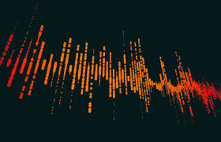
What is audio spectrum analyzer?
An audio spectrum analyzer is a tool used to visualize and analyze the frequency components of an audio signal. It is often used by audio engineers and musicians to identify and adjust specific frequencies in a sound
03
View More

Slide 5
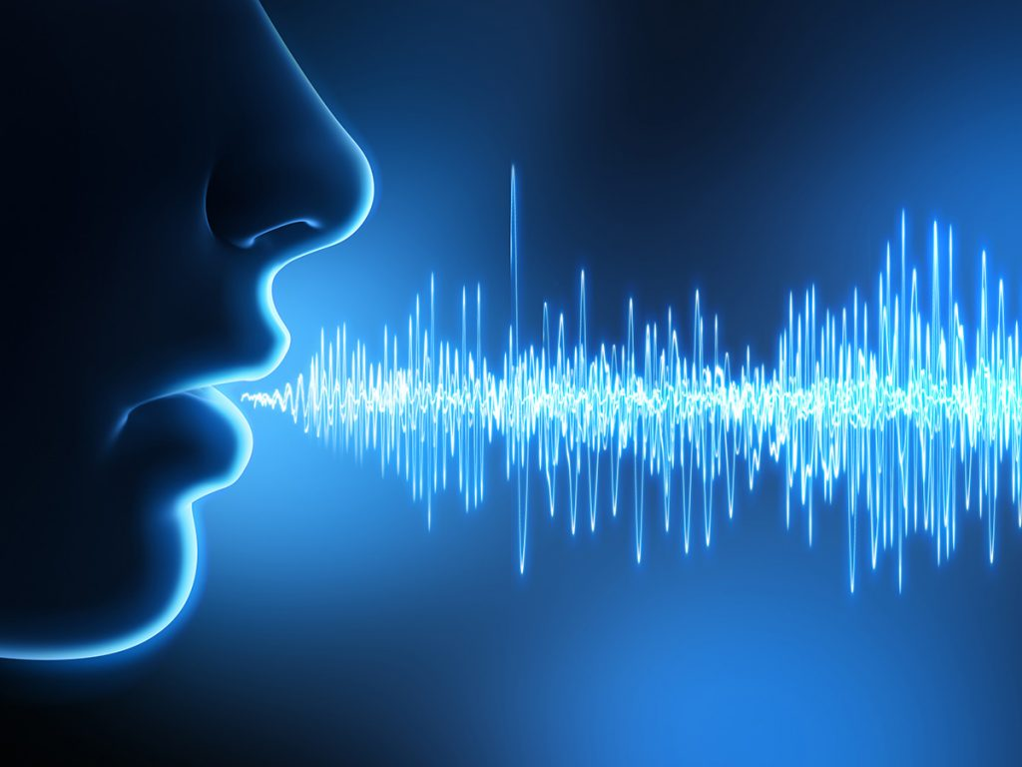
Python Modules and Libraries used
Methodology
Pyaudio
Matplotlib
Struct
Numpy
04
Still More

Slide 6
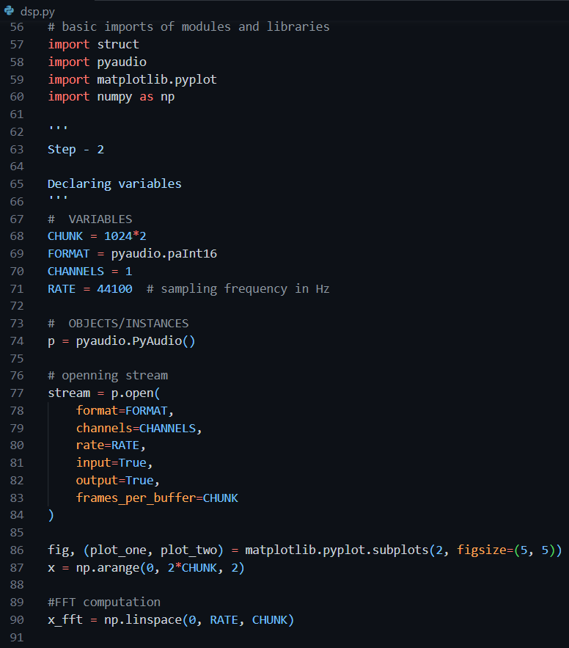
Part of the code
05

Slide 7
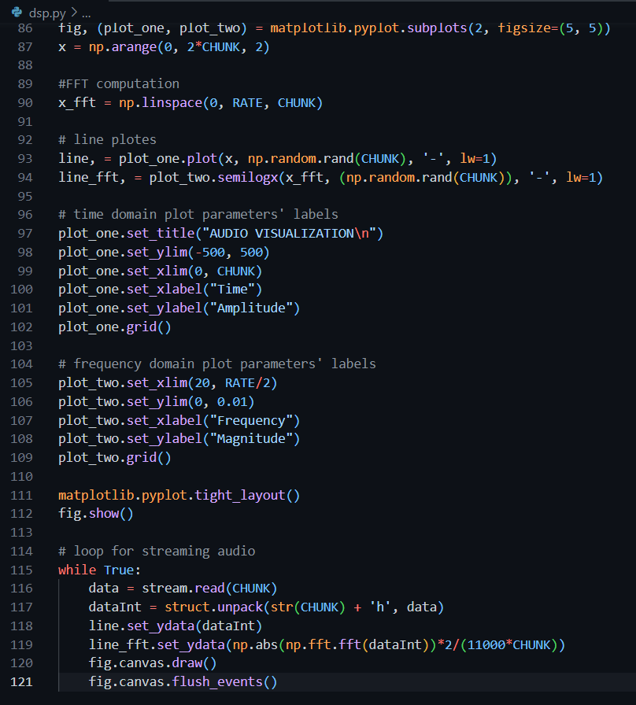
06

Slide 8
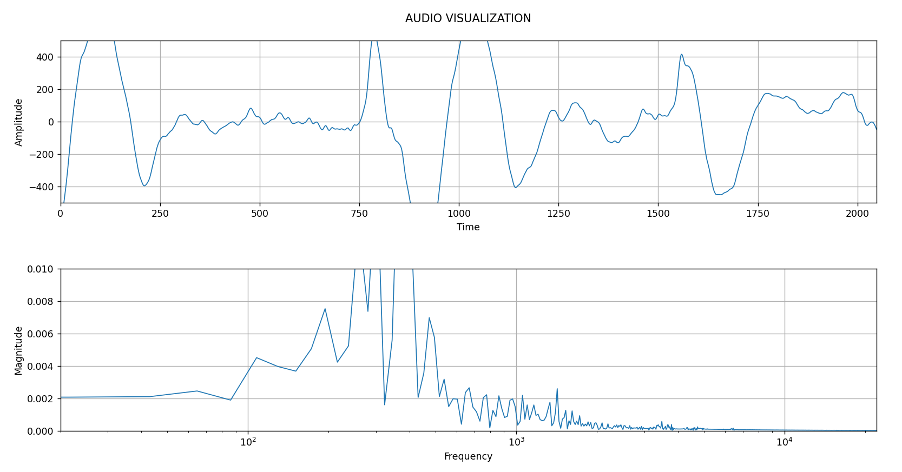
Output Example
(me speaking on the microphone)
07

Slide 9
T H A N K Y O U!
08

